Slide 1
Chapter 2: Acid–base equilibrium systems
What is an acid?

Slide 2
Terminology and definitions
You previously learnt that an acid produces hydrogen ions (H⁺) in an aqueous solution.
The reaction of an acid with water is an ionisation reaction as ions are formed.
Arrhenius and Bronsted-Lowry theories.

Slide 3
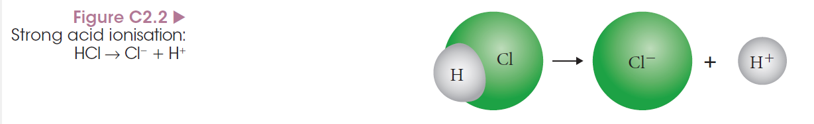
Strong and weak acids and bases
In a strong acid, almost all the acid molecules ionise. Examples include hydrochloric acid (HCl), nitric acid (HNO₃) and sulfuric acid (H₂SO₄).
When only some of the molecules ionise, the acid is considered to be weak. Examples include vinegar and citric acid.
Notes:
Get students to write equations to represent the ionisation of acids to form both hydrogen ions (H⁺) and hydronium ions (H₃O⁺) to understand the role of water:
HCl => H⁺ + Cl– and HCl + H₂O => H₃O⁺ + Cl–

Slide 4
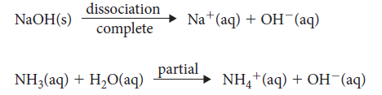
Strong and weak acids and bases
A strong base always dissociates in water to form separate ions. For example, sodium hydroxide (NaOH) separates to form sodium ions and hydroxide ions.
Weak bases only have a few ions form when added to water. Ammonia is a weak base.

Slide 5
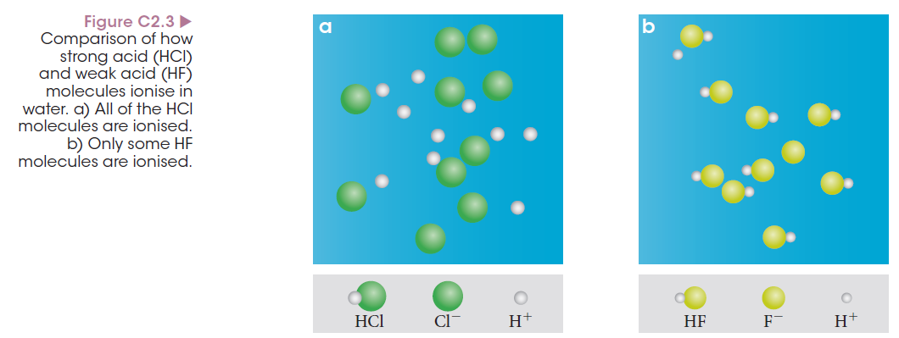
Strong and weak acids and bases

Slide 6
Concentration vs strength
Concentrated and dilute are terms often confused with strong and weak.
Strong and weak relates to the amount of dissociation, or percentage of ion formation, in water.
Concentrated and dilute refers to the amount of solute in a given amount of solution.

Slide 7
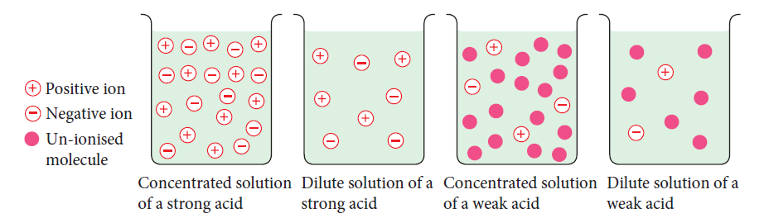
Concentration vs strength
An acid or base can be strong and concentrated, or strong and dilute.
The two terms are independent of each other.

Slide 8
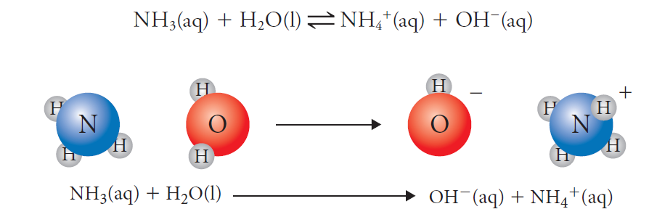
Brønsted–Lowry
Ammonia (base) accepts protons from the water (acid) in a proton transfer reaction.
Notes:
Use the example of ammonia and water to explain proton transfer.

Slide 9
Brønsted–Lowry
As more was learnt about acids and bases, the Brønsted–Lowry definitions were developed.
An acid is a substance that donates one or more protons or hydrogen ions (H⁺).
A base is a substance that accepts one or more protons.
Usually acids donate protons that are accepted by a base so they occur together.
Notes:
Show the difference between the common definition of a base as ‘something that produces hydroxide ions in water’. This is true for many bases but not true of all bases.

Slide 10
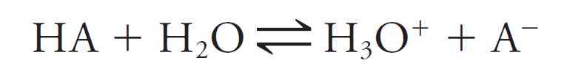
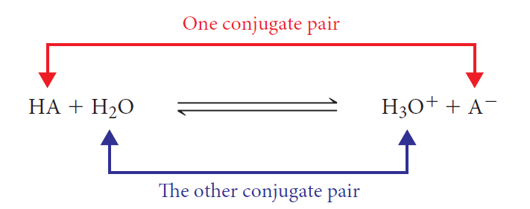
Mirrors and conjugate pairs
Using the Brønsted–Lowry definition, a general acid–base proton transfer reaction is developed.
The acid (HA) donates a proton to form A–.
These two are a conjugate pair.

Slide 11
Mirrors and conjugate pairs
Members of a conjugate acid–base pair differ from each other by the presence or absence of the transferable hydrogen ion (H⁺).
When hydrochloric acid is added to water, the hydrogen ion transfers from the acid to the water.

Slide 12
Chapter 2: Acid–base equilibrium systems
pH and water self ionisation

Slide 13
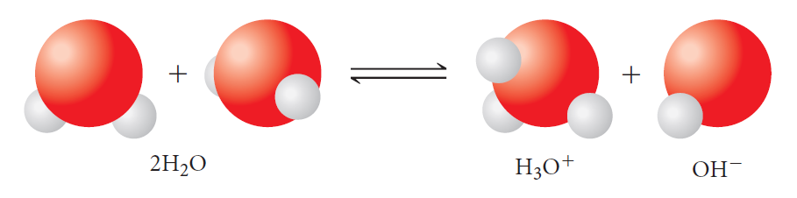
Self-ionisation of water
Water is an amphiprotic substance, acting as both an acid and a base.
Water will react with itself to form hydronium and hydroxide ions:
The presence of the ions means water can conduct electricity.

Slide 14
Self-ionisation of water
This is a reaction that heavily favours the left so only a small amount of ions are formed.
In pure water: [H₃O⁺] = [OH–] = 10^{–7} M.
This gives a pH of 7 and is considered neutral.
When [H₃O⁺] > [OH–] the solution is acidic.
When [H₃O⁺] < [OH–] the solution is basic.

Slide 15

Self ionisation of water is an endothermic process
Temperature (C)
K_{w} pH
0 0.144 x 10⁻¹⁴ 7.42
10 0.292 x 10⁻¹⁴ 7.27
25 1.00 x 10⁻¹⁴ 7.00
50 5.5 x 10⁻¹⁴ 6.62
100 55 x 10⁻¹⁴ 6.13
H₂O _{(l)} ↔ H⁺ _{(aq)} + OH⁻ _{(aq)} ∆H = 55.8kJ

Slide 16
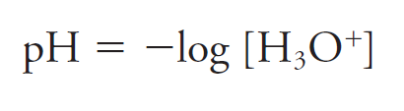
pH
The pH of a solution is defined as the negative logarithm (to the base 10) of the hydronium ion concentration.
It essentially measures the concentration of hydrogen ions in solution and can be calculated using the formula:
Notes:
You may need to revise the use and meaning of square brackets and use of significant figures in giving the final answer.

Slide 17
pH
A change in pH of one unit corresponds to a ten-fold change in the hydrogen ion concentration:
When [H₃O⁺] = 0.1 M, pH = 1.0
When [H₃O⁺] = 0.01 M, pH = 2.0
When [H₃O⁺] = 0.001 M, pH = 3.0
So [H₃O⁺] = 10^{–pH}

Slide 18
Polyprotic acids
A monoprotic acid such as HCl or HNO₃ can only donate one proton per molecule.
Diprotic acids such as H₂SO₄ can donate two protons per molecule.
Any acid that can donate two or more protons per molecule is a polyprotic acid and will have a higher concentration of hydrogen ions than a monoprotic acid of the same concentration.

Slide 19

Polyprotic acids
HCl (monoprotic) at 0.1 M has pH of 1.0, while H₂SO₄ (diprotic) at 0.1 M has pH of 0.69.
When sulfuric acid reacts with water it produces two hydrogen ions:
The higher concentration of hydrogen ions means a lower pH than for the monoprotic acid of the same concentration.

Slide 20
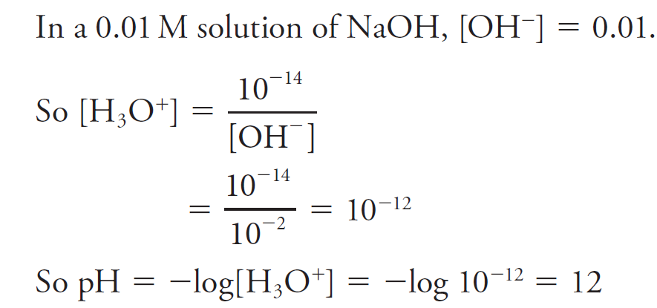
pH of alkaline solutions
The relationship between hydroxide and hydronium ion concentration in a solution is given by:
If hydroxide ion concentration is known, hydronium ion concentration can be calculated and hence pH.

Slide 21
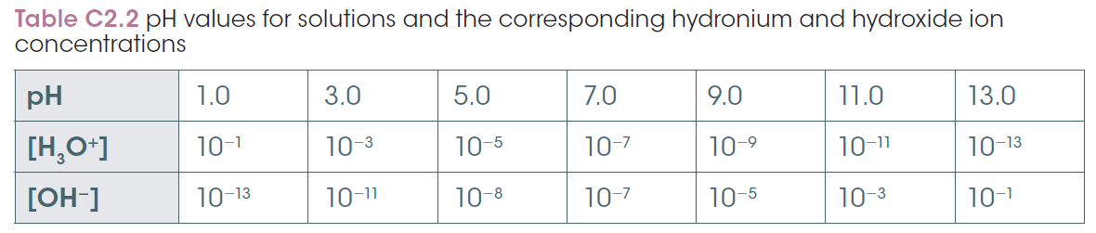
pH of alkaline solutions
The table shows the relationship between hydronium and hydroxide ions. Note that if multiplied, the two values always make 10^{–14}.
Note this Kw is assumed at 25ºC

Slide 22
Neutral solutions
A neutral solution occurs when [H₃O⁺] = [OH–].
A solution can be neutral but NOT have pH of 7. A pH of 7 only occurs when a strong acid and base are reacted together.
When a weak base is mixed with a strong acid the conjugate products also need to be considered and they will alter the final pH of the solution, making it acidic or basic.

Slide 23
Salts
A salt is formed when an acid and a base neutralise. It contains the anion from the acid and usually the metal cation from the base (where present). Salts are good electrolytes.
As various conjugate acids and bases form, the final solution can be acidic, basic or neutral depending on the substances that form.

Slide 24
Chapter 2: Acid–base equilibrium systems
Acidity constants: K_{a}

Slide 25

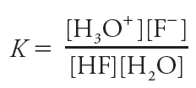
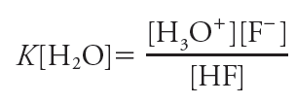
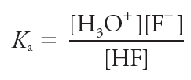
What is K_{a}?
In a weak acid, only some of the acid molecules ionise and an equilibrium forms. Using the weak acid HF (hydrofluoric acid):
The equilibrium expression can be rearranged to give the acid dissociation equilibrium constant, which is a measure of the strength of acids.
Notes:
Explain and show how the water can be removed due to its constant concentration, giving K_{a}.

Slide 26
Weak and strong substances and the K_{a} value
Strong acids ionise completely in water so the K_{a} value is large, because there is a greater proportion of the products making the fraction larger.
Weak acids only partially ionize, so the K_{a} value is small. The greater proportion of the reactants makes the overall fraction smaller.
Notes:
Use the equilibrium expression to show that a higher proportion of products give a larger number because the numerator is larger, while a higher proportion of reactants give a smaller number because the denominator is smaller.

Slide 27


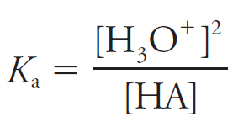
Determining K_{a}
Measuring the pH of an acid allows determination of K_{a}. Using a general acid base reaction:
The equilibrium expression becomes:
Because [A–] = [H₃O⁺], then:

Slide 28
Determining K_{a}
The following assumptions are made:
1 At equilibrium, [HA] is the same as the initial concentration because the weak acid only ionises to a very small amount in water.
2 The [H₃O⁺] produced by the self-ionisation of water does not have any effect on the calculation because it is so small.

Slide 29

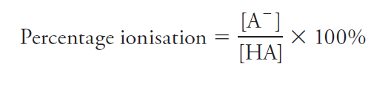
Percentage ionisation
Percentage ionisation – A simple calculation that determines the percentage of an acid that has ionised in water
The general reaction of acids with water:
Because [A–] = [H₃O⁺] for a monoprotic acid, the pH gives [H₃O⁺] and thus [A–] and percentage ionisation can be determined.

Slide 30
Polyprotic acids
Ionisation of a polyprotic acid happens in a series of steps, each with its own equilibrium expression and K_{a} value. Using sulfuric acid:
The first K_{a} value is usually the largest of the reactions, meaning that the HSO₄– is present in a higher proportion than the sulfuric acid or sulfate ion.

Slide 31
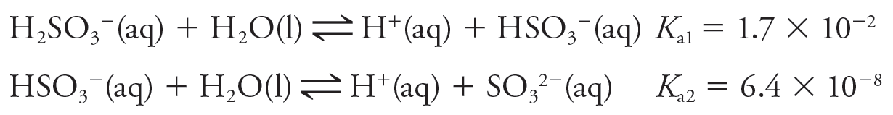
Polyprotic acids
A diprotic weak acid such as sulfurous acid (H₂SO₃) also occurs in two stages:
Note that the K_{a} values are much lower than for the strong acid.
There are appreciable quantities of all three species (H₂SO₃, HSO₃– and SO₃^{2–}) present in the solution.

Slide 32
Table of Acid and Base strength
Ka | Acid |  | Base
 | Name | Formula | Formula | Name
Large | Perchloric acid | HClO₄ | ClO₄ ⁻ | Perchlorate ion
3.2 * 10⁹ | Hydroiodic acid | HI | I- | Iodide
1.0 * 10⁹ | Hydrobromic acid | HBr | Br- | Bromide
1.3 * 10⁶ | Hydrochloric acid | HCl | Cl- | Chloride
1.0 * 10³ | Sulfuric acid | H₂SO₄ | HSO₄ ⁻ | Hydrogen sulfate ion
2.4 * 10¹ | Nitric acid | HNO₃ | NO₃ ⁻ | Nitrate ion
-------- | Hydronium ion | H₃O+ | H₂O | Water
5.4 * 10⁻² | Oxalic acid | HO₂C₂O₂H | HO₂C₂O₂⁻ | Hydrogen oxalate ion
1.3 * 10⁻² | Sulfurous acid | H₂SO₃ | HSO₃ ⁻ | Hydrogen sulfite ion
1.0 * 10⁻² | Hydrogen sulfate ion | HSO₄ ⁻ | SO₄ ²⁻ | Sulfate ion
7.1 * 10⁻³ | Phosphoric acid | H₃PO₄ | H₂PO₄ ⁻ | Dihydrogen phosphate ion
7.2 * 10⁻⁴ | Nitrous acid | HNO₂ | NO₃ ⁻ | Nitrite ion
6.6 * 10⁻⁴ | Hydrofluoric acid | HF | F - | Fluoride ion
1.8 * 10⁻⁴ | Methanoic acid | HCO₂H | HCO₂ ⁻ | Methanoate ion
6.3 * 10⁻⁵ | Benzoic acid | C₆H₅COOH | C₆H₅COO- | Benzoate ion
5.4 * 10⁻⁵ | Hydrogen oxalate ion | HO₂C₂O²⁻ | O₂C₂O₂ ²⁻ | Oxalate ion
1.8 * 10⁻⁵ | Ethanoic acid | CH₃COOH | CH₃COO | Ethanoate (acetate) ion
4.4 * 10⁻⁷ | Carbonic acid | CO₃ ²⁻ | HCO₃ ⁻ | Hydrogen carbonate ion
1.1 * 10⁻⁷ | Hydrosulfuric acid | H₂S | HS- | Hydrogen sulfide ion
6.3 * 10⁻⁸ | Dihydrogen phosphate ion | H₂PO₄ ⁻ | HPO₄ ²⁻ | Hydrogen phosphate ion
6.2 * 10⁻⁸ | Hydrogen sulfite ion | HS⁻ | S²⁻ | Sulfite ion
2.9 * 10⁻⁸ | Hypochlorous acid | HClO | ClO⁻ | Hypochlorite ion
6.2 * 10⁻¹⁰ | Hydrocyanic acid | HCN | CN⁻ | Cyanide ion
5.8 * 10⁻¹⁰ | Ammonium ion | NH₄ ⁺ | NH₃ | Ammonia
5.8 * 10⁻¹⁰ | Boric acid | H₃BO₃ | H₂BO₃ ⁻ | Dihydrogen carbonate ion
4.7 * 10⁻¹¹ | Hydrogen carbonate ion | HCO₃ ⁻ | CO₃ ²⁻ | Carbonate ion
4.2 * 10⁻¹³ | Hydrogen phosphate ion | HPO₄ ²⁻ | PO₄ ³⁻ | Phosphate ion
1.8 * 10⁻¹³ | Dihydrogen borate ion | H₂BO₃⁻ | HBO₃ ²⁻ | Hydrogen borate ion
1.3 * 10⁻¹³ | Hydrogen sulfide ion | HS- | S ²⁻ | Sulfide ion
1.6 * 10⁻¹⁴ | Hydrogen borate ion | HBO₃ ²⁻ | BO₃ ³⁻ | Borate ion
--------- | water | H₂O | OH- | Hydroxide

Slide 33
Chapter 2: Acid–base equilibrium systems
Indicators

Slide 34
What is an indicator?
An indicator is a molecular substance that changes colour as the pH of a solution changes.
An indicator is a weak acid and its conjugate base pair.
The weak acid is one colour and the conjugate base has a different colour.
Indicators change colour over different pH ranges.

Slide 35
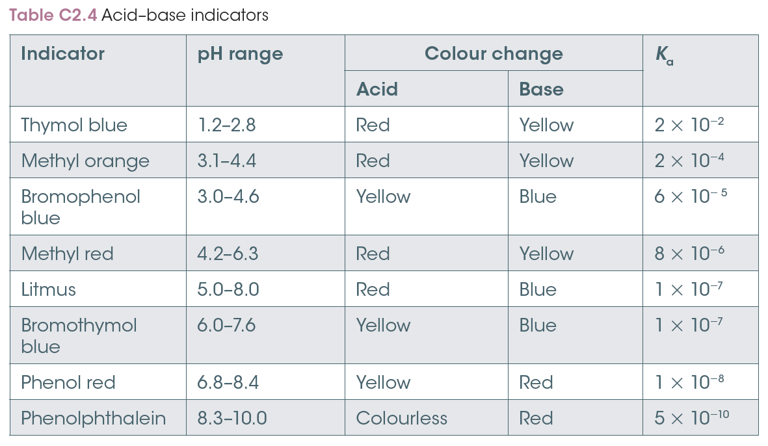
Common indicators

Slide 36
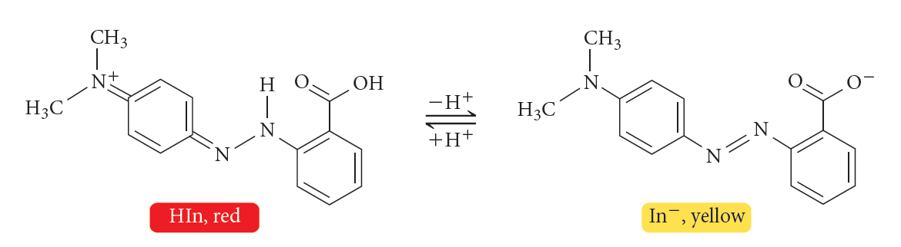
An example: methyl red
Methyl red is a common indicator that has an acid structure that is a bright red colour. It is represented by HIn (In for indicator; the H indicates it is an acid).
The conjugate base formed by the loss of the proton is a yellow colour. It is represented by In–.

Slide 37
An example: methyl red
When methyl red is added to an acidic solution, the equilibrium shifts to oppose the high concentration of hydronium ions.
The equilibrium shifts to the left as the hydronium ions react with the In– to form HIn. This results in the solution becoming bright red. Hence, methyl red is red in an acid.
When added to a base, equilibrium shifts right and more yellow In– forms.

Slide 38
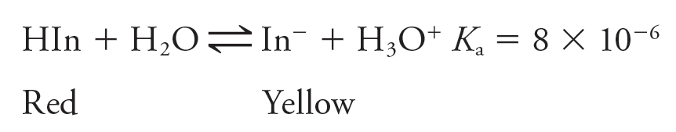
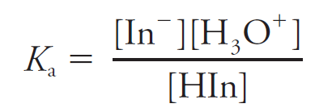
An example: methyl red
The equilibrium reaction that forms can be seen below:
Using this equation, the K_{a} expression can be written:

Slide 39
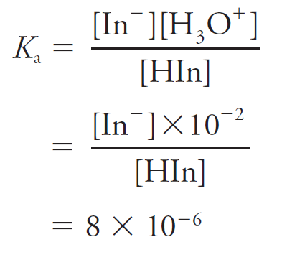
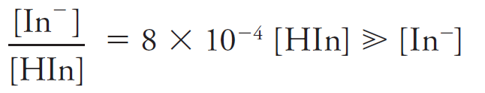
An example: methyl red
Using the equilibrium expression, it can be shown mathematically that there is a higher proportion of HIn in an acid solution. If pH = 2:
Hence the solution is bright red.

Slide 40
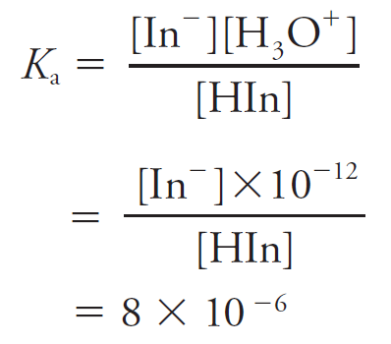
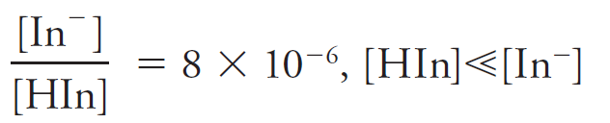
An example: methyl red
If pH = 12:
Hence the solution is yellow.

Slide 41
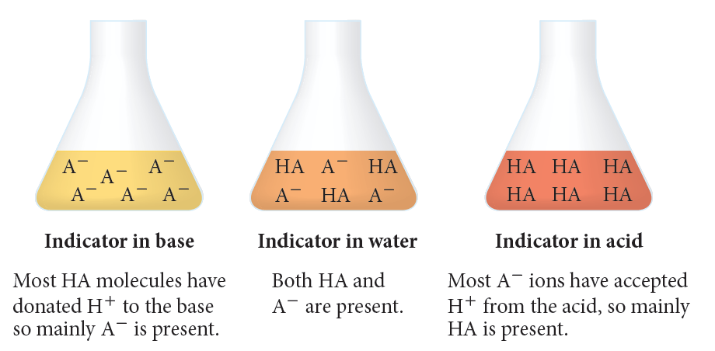
Indicators as a conjugate pair
Acid–base indicators are a conjugate pair with at least one form intensely coloured.

Slide 42
Chapter 2: Acid–base equilibrium systems
Buffers

Slide 43
What is a buffer?
Buffers are solutions that can maintain pH within a certain range, even if acids and bases are added to the solution.
Solutions that need to have pH maintained within a small range include your blood and saline aquariums.

Slide 44
How does a buffer work?
Buffers are solutions that contain a conjugate acid–base pairing where either the acid or base is weak. For example, carbonic acid and the hydrogen carbonate ion: H₂CO₃ / HCO₃–
The pH of a buffer is determined by:
the K_{a} of the weak acid
the ratio of weak base (A–) to weak acid (HA).

Slide 45

How does a buffer work?
The buffer equilibrium is:
If a strong acid is added, the extra hydronium ions shift the equilibrium to the left to reduce the concentration. Thus the pH increases to close to the original value.
The proportion of weak base (A–) and weak acid (HA) remains near constant, so there is only a small pH change.

Slide 46
Blood chemistry
The pH range of blood is 7.35–7.45.
The buffer system in blood is the carbonic acid/hydrogen carbonate ion system:
If the blood becomes acidic, the reverse reaction is favoured. If the blood becomes basic, the forward reaction occurs.

Slide 47

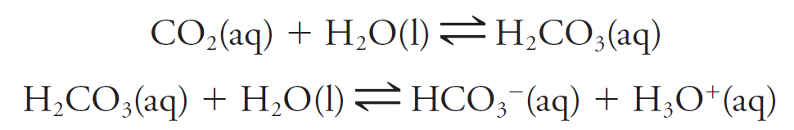
Blood chemistry
The blood buffer also controls the removal of carbon dioxide from the cells.
Carbon dioxide dissolves in blood:
It then reacts with water to form carbonic acid and is then transported in the blood, back to the lungs as the hydrogen carbonate ion.

Slide 48
Blood chemistry
The more carbon dioxide that dissolves, the more acidic the blood becomes. The buffer system results in the decrease of this acid and an increase in the pH.
When the blood reaches the lungs, the reverse reactions occur until gaseous carbon dioxide is formed and breathed out.

Slide 49

Blood chemistry
The carbon dioxide levels in the lungs are lower than in the blood.
The first reaction is shifted left, reducing aqueous carbon dioxide. This shifts the second and third reaction to the left as well, resulting in an overall reduction of hydronium ions, maintaining the pH.

